Slide 1
Final Presentation
Zach Livingston

Slide 2
Kai ‘Opua
Project Preview:
http://collinhover.github.io/kaiopua/

Slide 3
Source Code:
https://github.com/collinhover/kaiopua

Slide 4
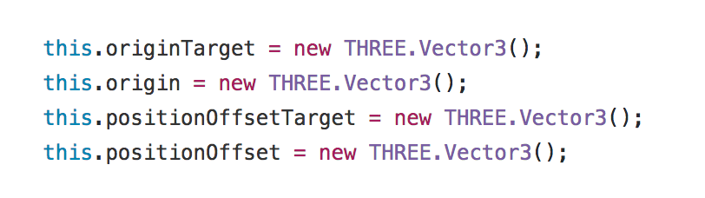
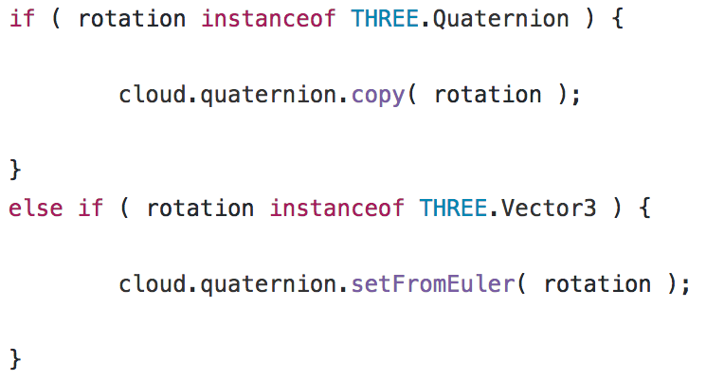
Graphics Pipeline :
Kai ‘Opua utilizes the three.js library for it’s graphics pipeline.

Slide 5
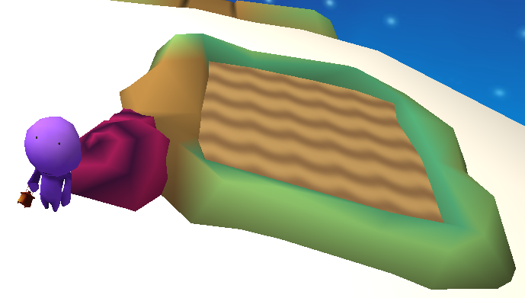
Interaction :
Kai ‘Opua is a 3JS and WebGL puzzle game where you learn to the ways of taro farming. You do this by exploring the island and farming.

Slide 6
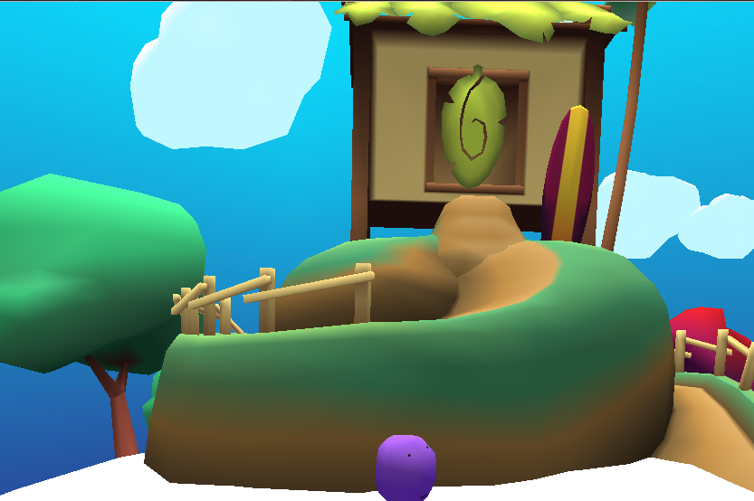
Geometric Objects :
Kai ‘Opua is filled with a range of simple and complex geometric objects.
These objects form the whale that you are standing on.

Slide 7
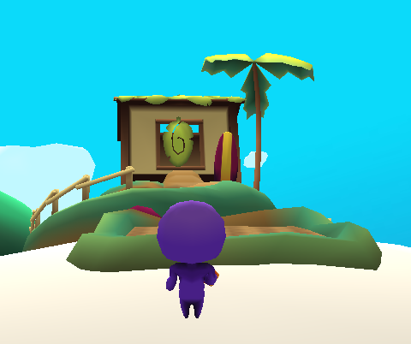
Transformation :
Camera Transformation:
The camera follows the character around the scene from a static view.
Object Transformation:
As you move you rotate with the world, giving depth.

Slide 8
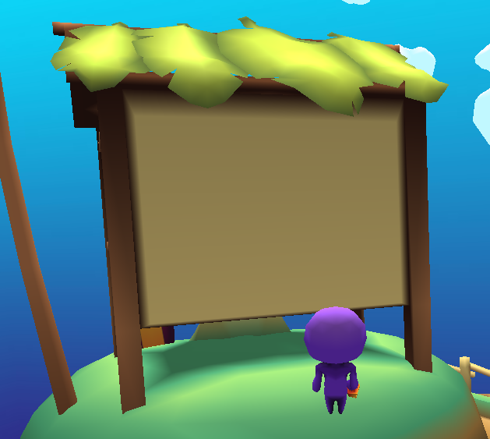
Projection :
The layered leafs on the house project a shadow onto the side of the house. This same effect can be seen with the shadow below the house,

Slide 9
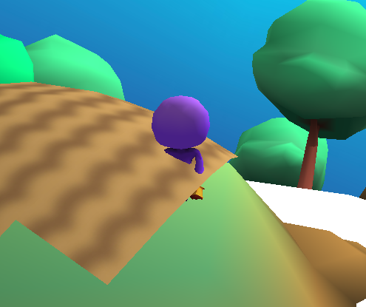
Clipping :
The ground itself does not clip. The player can move and stand on the ground.
The dirt however clips, and allows the player to walk through the object.

Slide 10
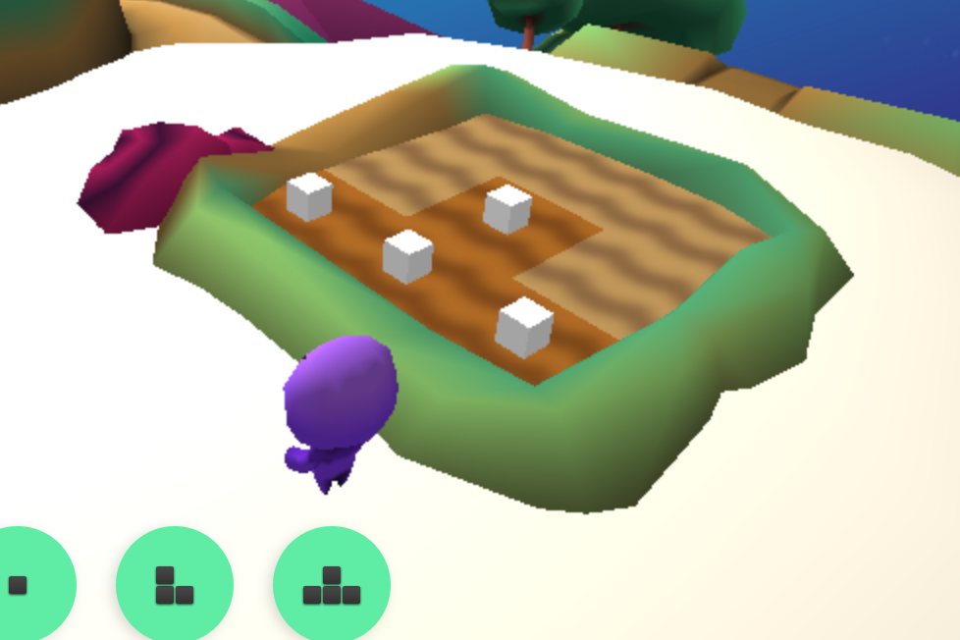
Rendering:
After using the farming tool to plant taro, the game renders white cubes to represent them.

Slide 11
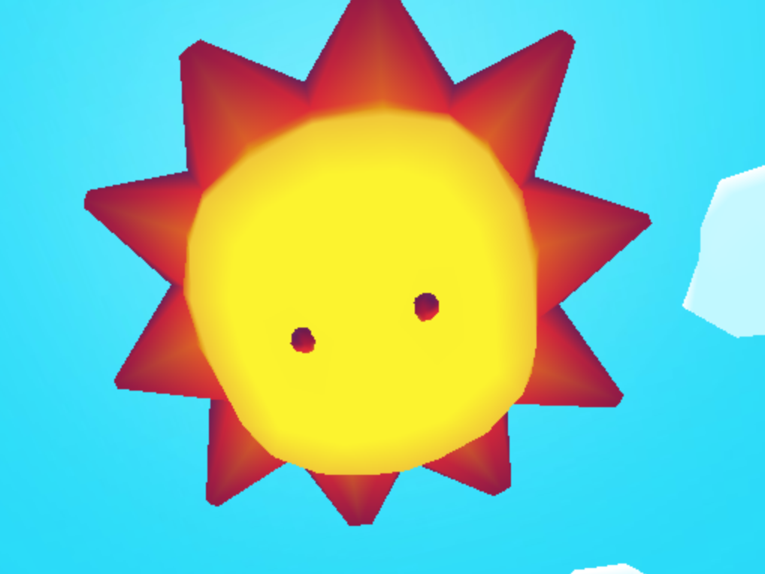
Lighting:
There is ambient light in the scene that gives general lighting. Where as the sun is a directional light that cast creates shadows.

Slide 12
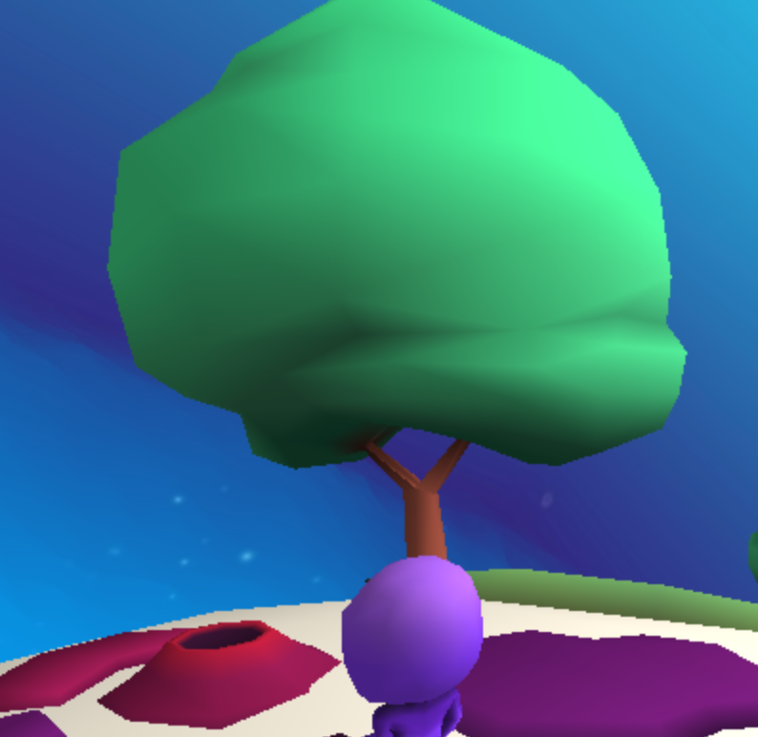
Shading:
Kai ‘Opua uses Goraud Shading. The shading on the tree is smooth and it not defined in terms of the trees geometry.

Slide 13
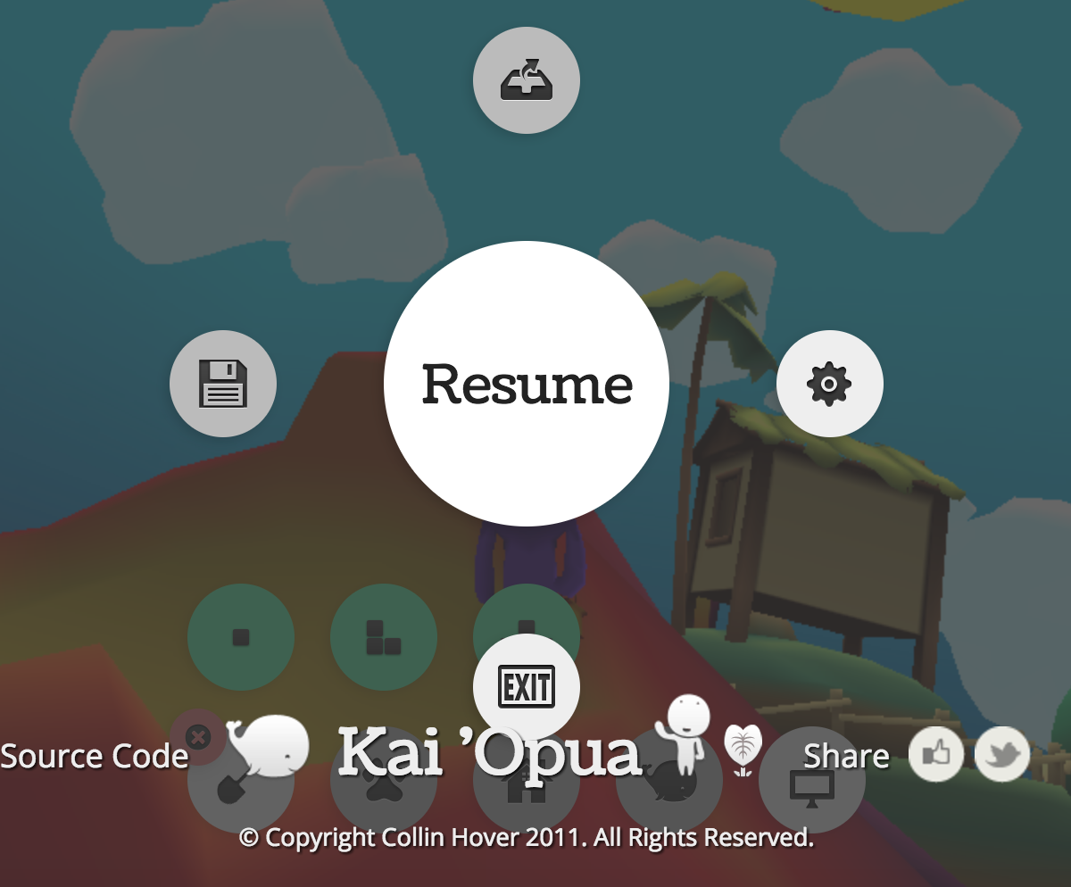
Advanced Rendering:
The pause menu and game are both rendered when the game is no longer in focus or you hit the pause menu.

